Slide 1
Movie Recommendation Website
Group-1

Slide 2
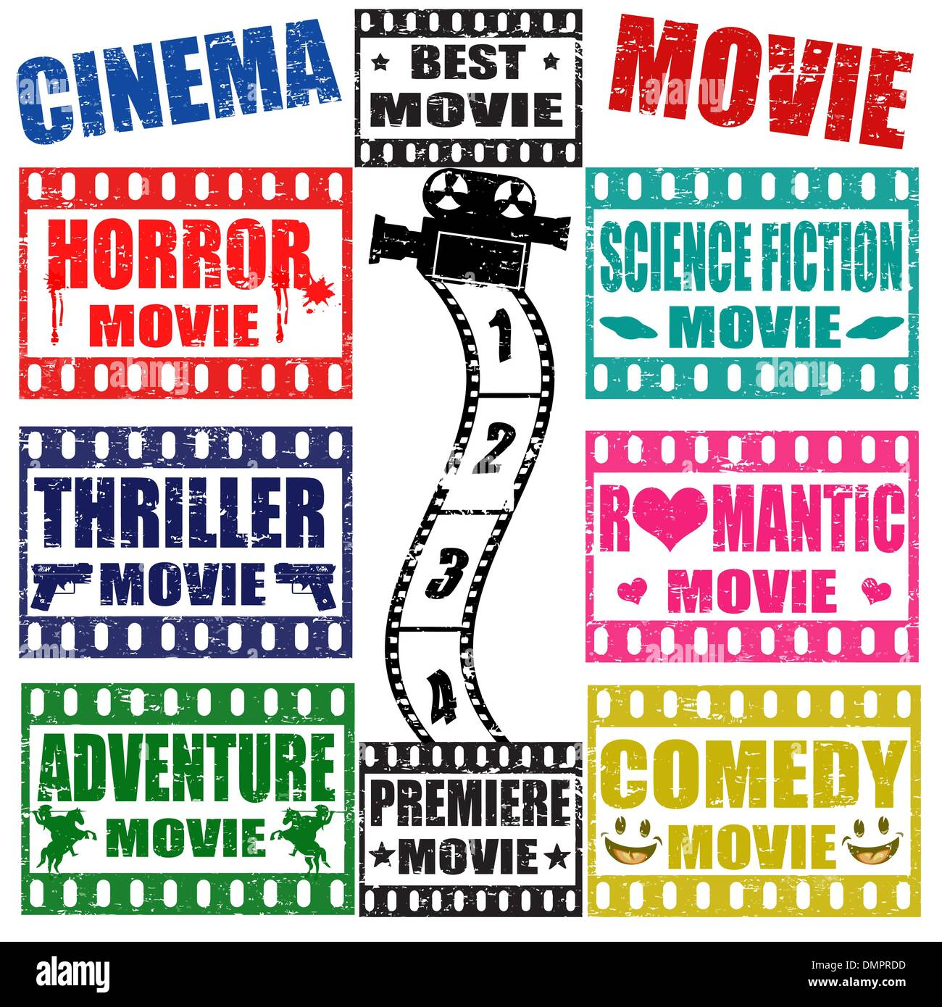
APPLICATION
User's Film preference:
The Primary Goal Of Movie Recommendation Systems Is To Filter And Predict Only Those Movies That Corresponding User Is Most Likely wanting To watch.
How does it work?
The Recommendation System Analyzes The Preferences Of The User Concerned, and Then It Uses This Information To Try To Find Similar Movies.

Slide 3
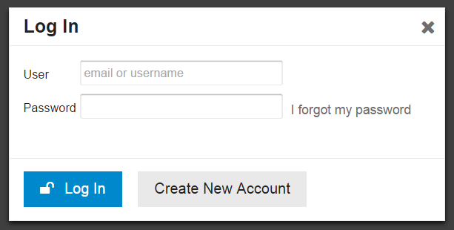
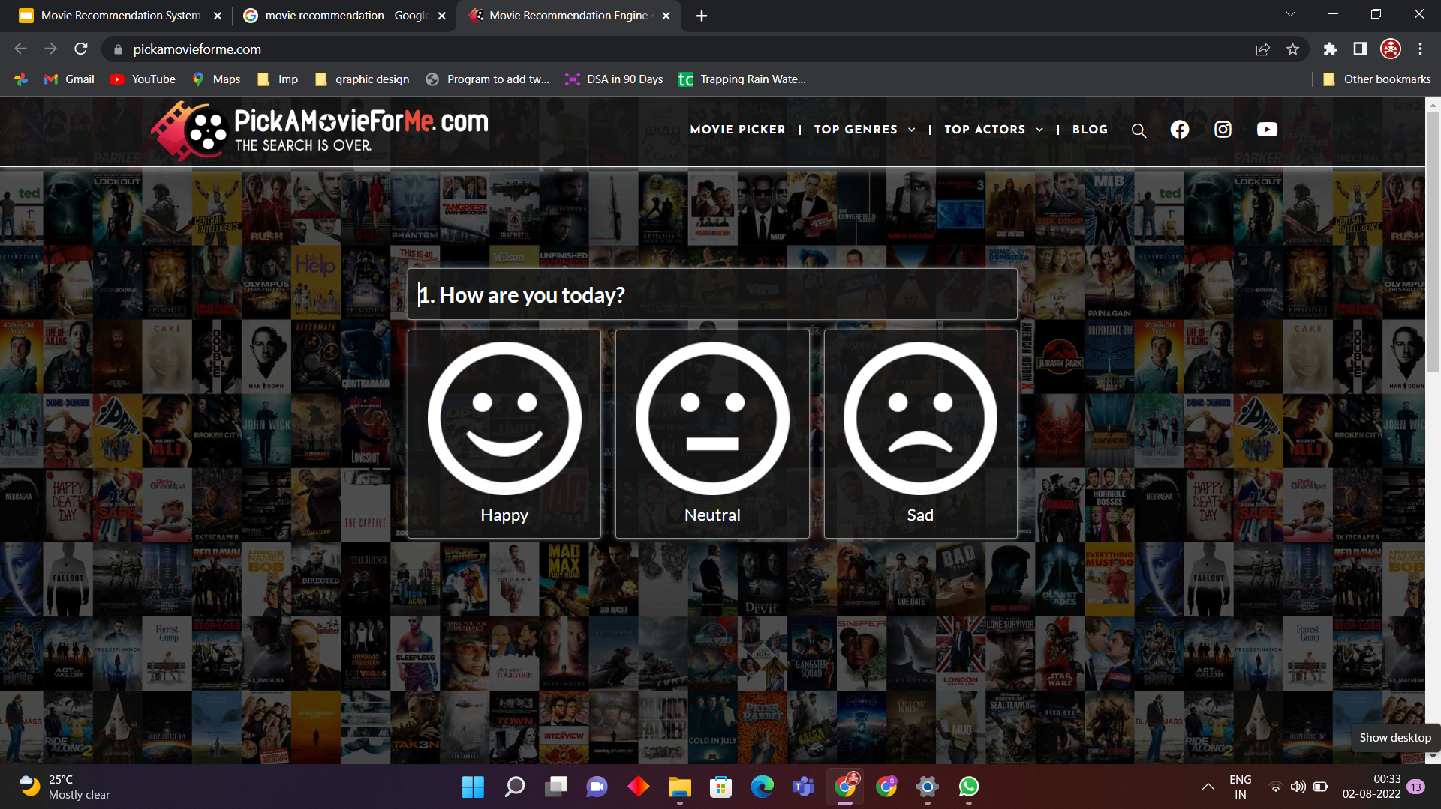
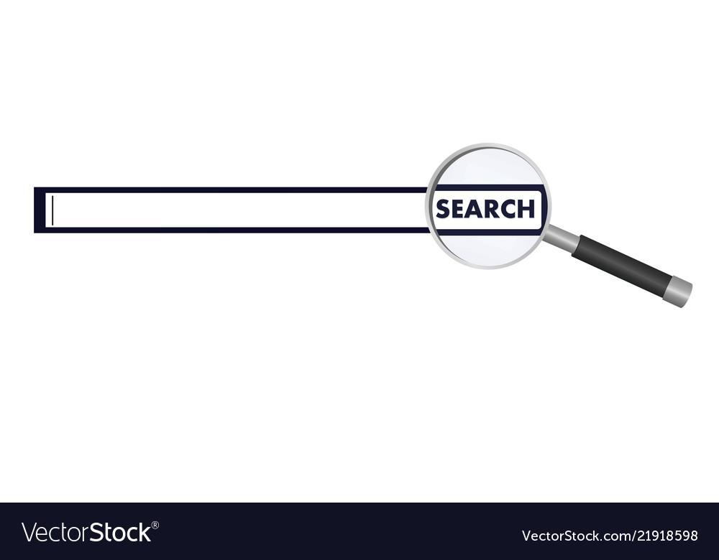
System Requirements:-
User Login/Sign Up Dialog Box:-
This is where the user will type his credentials to access the website in order for his data to be secured/saved for future reference.
Preference Enquiry:-
This will enquire the user about his/her preference of all the favorites and likings i.e, genres,actors,casts etc.
Search tab:-
This will enable the user to Search a particular movie based on which he/she would get the appropriate recommendation.

Slide 4
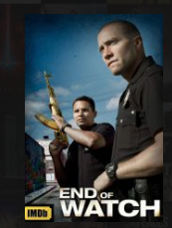


Welcome page:-
The user will be provided with Posters of the movies and the associated links of trailers and full movie link wherever it is available.
Recommend Button- On clicking this button user will get the recommendations.
Review/Rating-At last upon all the recommendations provided to the user, he/she will be asked to rate the recommendations provided to him or give reviews and suggestions on the provided recommendations.

Slide 5
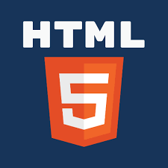
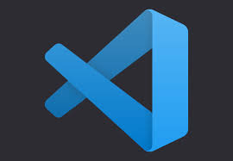
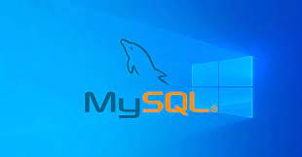

TOOLS UTILIZED:
VS CODE:-In contrast, Visual Studio Code can be blites.
essed as an integrated development environment(IDE), meaning that developers can write can write and test code at the same time.
DJANGO:-Django is a high-level Python web framework that enables rapid development of secure and maintainable webs.
MySQL:-MySQL is an open source relational database management system. For WordPress sites,
That means it helps you store all your blog posts ,users, plugin information, etc.
HTML:-HTML is the language for describing the structure of Web pages .HTML gives authors the means to:
Publish online documents with headings ,text, tables ,list, photos, etc.
PyCharm is a dedicated Python Integrated Development Environment(IDE) providing a wide range of essential tools for Python developers ,tightly integrated to create a convenient for productive Python, web, and data science development.
TMDB:-The Movie Database(TMDB) is a community built movie and TV database.

Slide 6

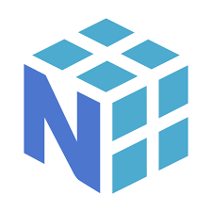
Pandas:-Pandas is mainly used for data analysis and associated manipulation of tabular data in data frames.
Jupyter Notebook:-The Jupyter Notebook is an open source web application that you can use to create and
Share documents that contain live code , equations, visualization, and text.
CSV File:-A CSV (comma separated values) file is a text file that has a specific format which allows
Data to be saved in a table structured format.
Scikit Library:-Scikit-learn is a free machine learning library for python.
NumPy:-NumPy is a Python library used for working with arrays. It also has functions for working in domain
Of linear algebra, fourier transform, and matrices.

Slide 7
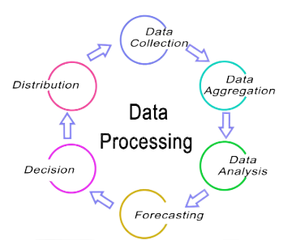
Data Fetching & Processing
Fetching data from TMDB website then, using numpy and pandas for preprocessing of data to get valuable data for building machine learning module....

Slide 8
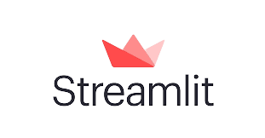
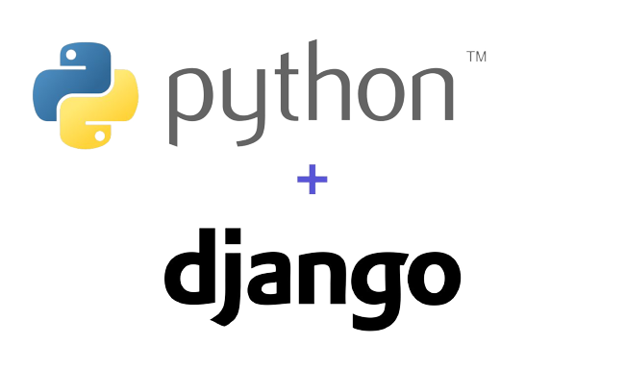

ANY PYTHON FRAMEWORK
Python Web framework is a collection of packages or modules that allow developers to write Web applications or services. With it, developers don’t need to handle low-level details like protocols, sockets or process/thread management.
Python web framework will help you with:Interpreting requests (getting form parameters, handling cookies and sessions)Producing responses (presenting data as HTML or in other formats).Storing data persistently (and other things)
M.L MODEL
A machine learning model is a file that has been trained to recognize certain types of patterns. You train a model over a set of data, providing it an algorithm that it can use to reason over and learn from those data.

Slide 9
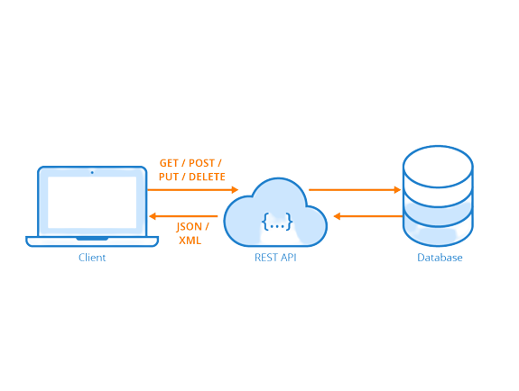
API
API stands for Application Programming Interface. In the context of APIs, the word Application refers to any software with a distinct function. Interface can be thought of as a contract of service between two applications. This contract defines how the two communicate with each other using requests and responses.

Slide 10

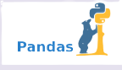
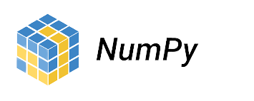
Data Flow
Start
Data gathering from tmdb
Acquire user’s data
From website
Data preprocessing using numpy and pandas
Preprocessing user’s data using numpy and pandas
Store data
Data modeling
Store user’s data
Display data on website
End

Slide 11
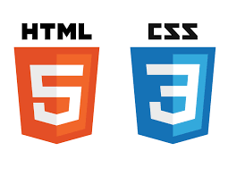
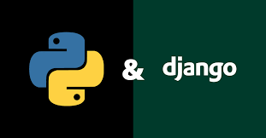
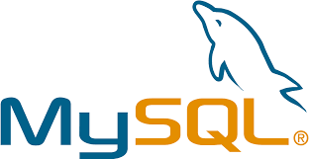
Architecture Diagram

Slide 12
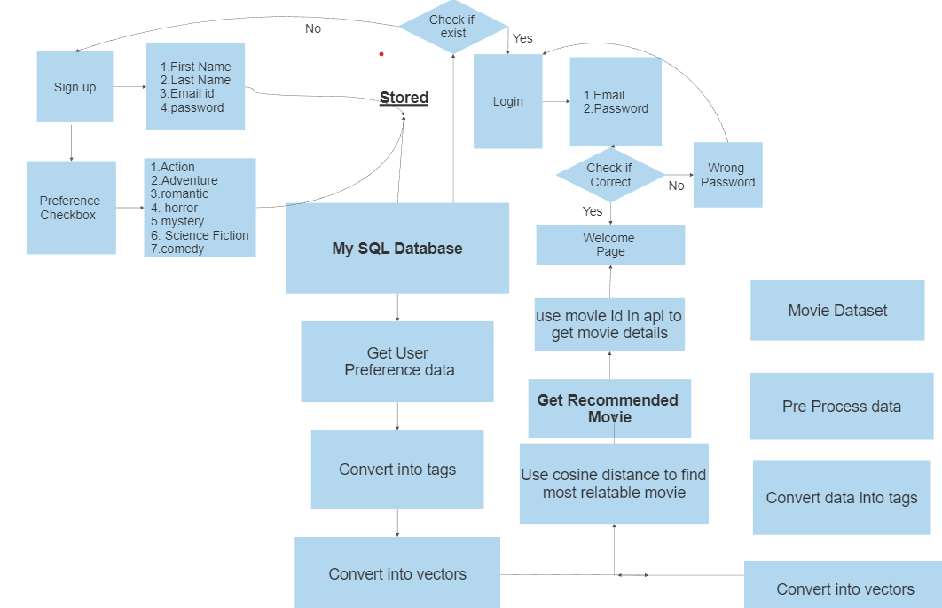
Graphical Explanation

Slide 13
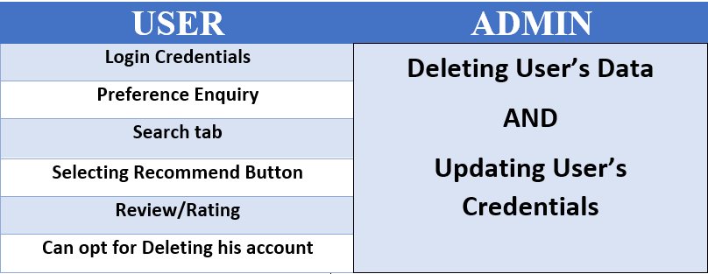
Listings:

Slide 14
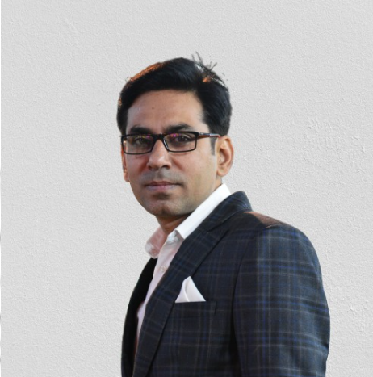
Thanks to our Supervisor Mr. Anand Motwani
Prof. Anand Motwani is Brilliant academician and
researcher with 20+ years’ experience of training,
teaching and guiding technical scholars and corporate
employees. He is an alumni of Maulana Azad National
Institute of Technology (MANIT), Bhopal, (M.P., India).
has worked with renowned educational Institutions at
good positions. He has been associated with different
universities as a guest faculty, a counsellor, an
examiner and for other academic assignments. He has
experience of planning and developing customized
courses and training materials.

Slide 15
Contribution of each member
Manan Sharma (21BCE10210) - Designing M.L Module and back-end
P Harshit Kumar (21BCE10709)- Preprocessing/handling data and back-end
Arnav Sinha (21BCE10168)- Designing M.L Module and back-end
Arvind Garg (21BCE10184)-Front-end(django)
Shivang Choudhary (21BCE10188)-Front-end(django)

Slide 16
Thanks!

